Slide 1

Unit-4: Wi-Fi and the IEEE 802.11 Wireless LAN Standard
Mobile Computing Wireless Communication
(MCWC)
GTU # 2170710
Prof. Swati R Sharma
Computer Engineering Department
swati.sharma@darshan.ac.in
(O) 9727747317

Slide 2
Wireless LAN

Looping
Topics to be covered
Wi-Fi and the IEEE 802.11 Wireless LAN Standard –
IEEE 802 architecture
IEEE 802.11 architecture and services
IEEE 802.11 Medium access control
IEEE 802.11 physical layer
Wi-Fi protected access

Slide 3
Introduction of WLAN

Slide 4

Introduction of WLAN
The most prominent specification for wireless LANs (WLANs) was developed by the IEEE 802.11 working group.
It is a network that allows devices to connect and communicate wirelessly.
Unlike a traditional wired LAN, in which devices communicate over Ethernet cables, devices on a WLAN communicate via Wi-Fi.
Mobile users can access information and network resources through wireless LAN as they attend meetings, collaborate with other users, or move to other locations in the premises.
WLAN is not a replacement for the wired infrastructure. It implemented as an extension to a wired LAN within a building or campus.

Slide 5
Advantages of WLAN

Slide 6
Advantages of WLAN
Mobility
Low Implementation Cost
Installation Speed and Simplicity
Network Expansion
Reduced Cost-of-Ownership
Reliability
Scalability
Usage of ISM band

Slide 7
Applications of WLAN

Slide 8
Applications of WLAN
Office/Campus Environment
Factory Shop Floor
Home
Workgroup Environment
Heritage Buildings
Public Places
War/Defense Sites

Slide 9
Types of WLAN

Slide 10
Types of WLAN
802.11
HyperLAN (or HiperLAN)
HomeRF
Ad-hoc Network
Bluetooth
Zigbee

Slide 11
IEEE 802.11 Wireless LAN Standard

Slide 12
IEEE 802.11 Wireless LAN Standard
IEEE 802.11 standard for wireless LAN operations at a data rate up to 2 Mbps in the 2.4 GHz Industrial, Scientific, and Medical(ISM) band.
802.11 and 802.11x refer to a family of specifications developed by the IEEE for wireless LAN (WLAN) technology.
802.11 specifies an over-the-air interface between a wireless client and a base station or between two wireless clients.
The IEEE accepted the specification in the year 1997.

Slide 13
Mobile Communication Technology according to IEEE
Local wireless networks
WLAN 802.11
802.11a
802.11h
802.11i/e/…/w
802.11b
802.11g
ZigBee
Personal wireless nw
WPAN 802.15
802.15.4
802.15.4a/b
802.15.5
802.15.2
802.15.3
802.15.3a/b
802.15.1
Bluetooth
Wireless distribution networks
WMAN 802.16 (Broadband Wireless Access)
WiMAX
+ Mobility
802.20 (Mobile Broadband Wireless Access)

Slide 14
WiFi vs WiMAX

Slide 15
WiFi vs WiMAX
Features | WiFi | WiMAX
IEEE Standard | IEEE 802.11x | IEEE 802.16
Data Rate | 300 Mbps | 70 Mbps
Transmission Range | 300 meter | 50Km
Transmission Range | 300 meter | 50Km
Application | WiFi is for LAN applications | WiMAX is for MAN applications
QoS | WiFi does not guarantee any Quality of Service (Qos) | WiMax guarantee Quality of Service (Qos)
Application | WiFi is for LAN applications | WiMAX is for MAN applications

Slide 16
Introduction to Wi-Fi

Slide 17

Introduction to Wi-Fi
Short for wireless fidelity.
It is a wireless technology that uses radio frequency to transmit data through the air.
Wi-Fi is based on the 802.11 standard:
802.11a
802.11b
802.11g

Slide 18
Specification in IEEE 802.11

Slide 19
Specification in IEEE 802.11
There are several specifications in the 802.11 families:
802.11a − This is an extension to 802.11 that pertains to wireless LANs and goes as fast as 54 Mbps in the 5-GHz band.
802.11b − The 802.11 high rate WiFi is an extension to 802.11 that pertains to wireless LANs and yields a connection as fast as 11 Mbps transmission (with a fallback to 5.5, 2, and 1 Mbps depending on the strength of signal) in the 2.4-GHz band.
802.11g − This pertains to wireless LANs and provides 20+ Mbps in the 2.4-GHz band.

Slide 20
Ad-hoc versus Infrastructure Mode

Slide 21
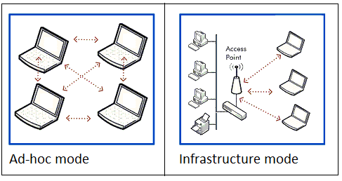
Ad-hoc versus Infrastructure Mode
In an Ad-hoc mode, there is no access point or infrastructure.
A number of mobile stations form a cluster to communicate with each other.
keyword in an adhoc network is decentralization
Each node participates in routing.
In an infrastructure mode, the mobile stations (MS) connected to a base station or Access Point (AP).
It is similar to a star network where all the mobile stations are attached to the base station.
Need to set up dedicated machines to act as routers/access point.
Due to the fixed nature of the network initial expense of setting up can be quite high.

Slide 22
IEEE 802.11 Terminology

Slide 23
IEEE 802.11 Terminology
802.11 LAN
802.x LAN
STA₁
BSS₁
Access
Point
Portal
Distribution System
ESS
Access
Point
BSS₂
STA₂
802.11 LAN
STA₃

Slide 24
IEEE 802.11 Terminology
Access point (AP) | Any entity that has station functionality and provides access to the distribution system via the wireless medium for associated stations
Basic service set (BSS) | A set of stations controlled by a single coordination function
Coordination function | The logical function that determines when a station operating within a BSS is permitted to transmit and may be able to receive PDUs
Distribution system (DS) | A system used to interconnect a set of BSSs and integrated LANs to create an ESS
Extended service set (ESS) | A set of one or more interconnected BSSs and integrated LANs that appear as a single BSS to the LLC layer at any station associated with one of these BSSs
MAC protocol data unit (MPDU) | The unit of data exchanged between two peer MAC entities using the services of the physical layer
MAC service data unit (MSDU) | Information that is delivered as a unit between MAC users
Station | Any device that contains an IEEE 802.11 conformant MAC and physical layer

Slide 25
IEEE 802.11 Terminology

Slide 26
IEEE 802.11 Terminology
802.11 LAN
802.x LAN
STA₁
BSS₁
Access
Point
Portal
Distribution System
ESS
Access
Point
BSS₂
STA₂
802.11 LAN
STA₃

Slide 27
IEEE 802.11 Terminology
Direct communication within a limited range
Station (STA): terminal with access mechanisms to the wireless medium
Independent Basic Service Set (IBSS): group of stations using the same radio frequency
802.11 LAN
STA₁
IBSS₁
STA₃
STA₂
IBSS₂
STA₅
STA₄
802.11 LAN

Slide 28
IEEE 802 ARCHITECTURE
The IEEE 802 Standard comprises a family of networking standards that cover the physical layer specifications of technologies from Ethernet to wireless.
IEEE 802 is subdivided into 22 parts that cover the physical and data-link aspects of networking.

Slide 29
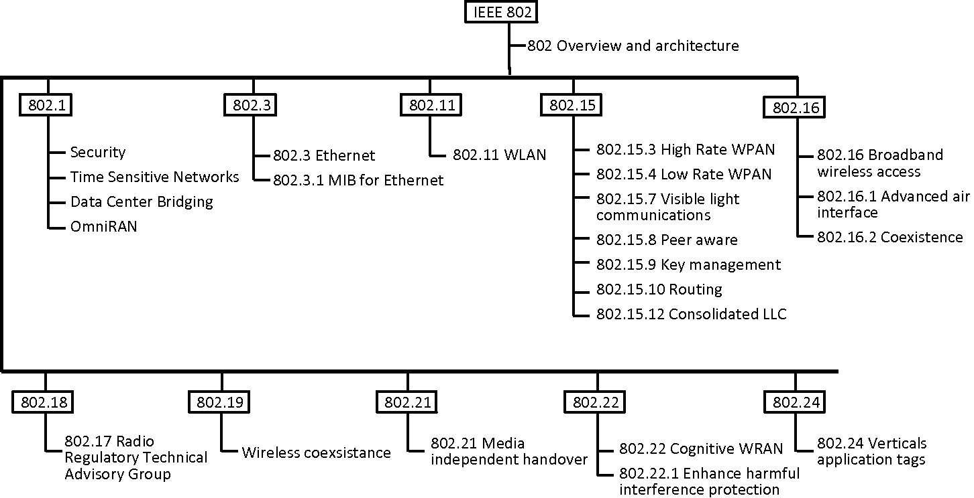

Slide 30
IEEE 802.11 Architecture

Slide 31
IEEE 802.11 Architecture
IEEE 802.x LAN
Extended Service Set (ESS)
portal
Distributed System (DS)
Access point (AP)
Access point (AP)
Basic Service Set (BSS)
STA1
STA5
STA2
STA4
STA7
STA3
STA6
Basic Service Set (BSS)
The whole interconnected Wireless LAN, including the different cells, their respective Access Points and the Distribution System are called as Extended Service Set (ESS).
Although a wireless LAN may be formed by a single cell, with a single Access Point, most installations will be formed by several cells, where the access points are connected through some kind of backbone.
This backbone is called Distribution System (or DS).
This backbone is typically Ethernet and, in some cases, is wireless itself.
In the 802.11 architecture, one cell or a BSS is controlled by one Base Station.
This base station is called Access Point or AP in short.

Slide 32
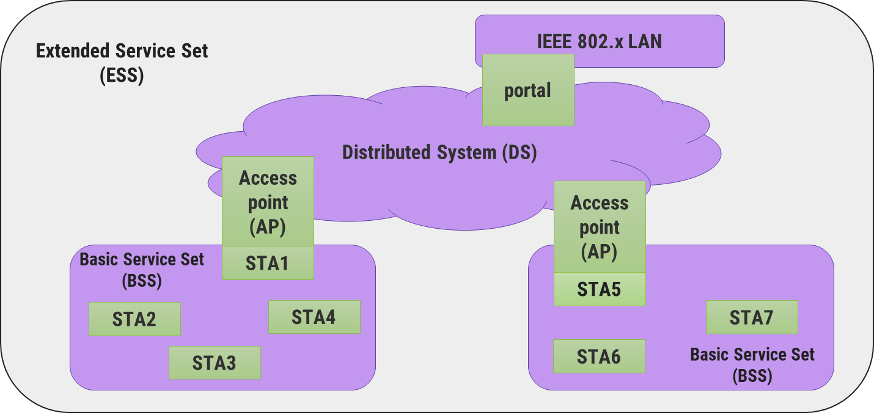
IEEE 802.11 ARCHITECTURE
In the 802.11 architecture, one cell or a BSS is controlled by one Base Station.
This base station is called Access Point or AP in short.
Although a wireless LAN may be formed by a single cell, with a single Access Point, most installations will be formed by several cells, where the access points are connected through some kind of backbone.
This backbone is called Distribution System (or DS).
This backbone is typically Ethernet and, in some cases, is wireless itself.
The whole interconnected Wireless LAN, including the different cells, their respective Access Points and the Distribution System, is seen as a single 802 network to the upper layers of the OSI model and is called as Extended Service Set (ESS).

Slide 33
IEEE standard 802.11 Protocol Stack
fixed
terminal
mobile terminal
infrastructure
network
access point
application
application
TCP
TCP
IP
IP
LLC
LLC
LLC
802.11 MAC
802.11 MAC
802.3 MAC
802.3 MAC
802.11 PHY
802.11 PHY
802.3 PHY
802.3 PHY

Slide 34
IEEE 802.11 Stack
802.2
Data Link Layer
802.11 MAC
MAC Layer
Frequency Hopping
Direct Sequence
Infrared
Physical
Layer
PLCP
Sublayer
PMD
Sublayer
The 802.11 standards cover definitions for both MAC (Medium Access Control) and Physical Layer.
The standard currently defines a single MAC, which interacts with three Physical Sublayers:
Frequency Hopping Spread Spectrum
Direct Sequence Spread Spectrum
InfraRed
PLCP layer prepares the MAC Protocol Data Unit (MPDU) for transmission.
The PLCP also delivers the incoming frames from the wireless medium to the MAC layer.
Physical Medium Dependent (PMD):
The PMD provides the actual transmission and reception of physical layer entities between stations through the wireless media.
PMD sub layer provides the modulation/demodulation of the transmission.
Frequency Hopping Spread Spectrum (FHSS) Layer:
The layer carries the clocking information to synchronize the receiver clock with the clock of the transmitted packet.
FHSS PMD is responsible for converting the binary bit sequence into analog signal and transmit the PPDU frame into the air.
FHSS PMD does this using the frequency hopping technique.
DSSS PLCP is responsible for synchronizing and receiving the data bits correctly.
DSSS PMD translates the binary digital sequence into analog radio signals and transmits the PPDU frame into the air.
The DSSS physical layer operates within the ISM band.
The architecture of the Physical layer comprises of the two sub layers for each station:
Physical Layer Convergence Procedure (PLCP)
Physical Medium Dependent (PMD)
Physical Layer Convergence Procedure (PLCP):
PLCP sub layer is responsible for the Carrier Sense (CS) part of the Carrier Sense Multiple Access/Collision Avoidance (CSMA/CA) protocol.

Slide 35
802.11 - Layers and functions
MAC
access mechanisms, fragmentation, encryption
MAC Management
synchronization, roaming, power management
PLCP Physical Layer Convergence Protocol
clear channel assessment signal (carrier sense)
PMD Physical Medium Dependent
modulation, coding
PHY Management
channel selection, MIB (Management Information Base)
Station Management
coordination of all management functions
Station Management
LLC
DLC
MAC
MAC Management
PLCP
PHY Management
PHY
PMD

Slide 36
IEEE 802.11 Services

Slide 37
IEEE 802.11 Services
Some Electronic Device
(Mobile, Laptop etc)
Station
Distribution System
Terminate connection with AP
Evasdropping
Authentication
Privacy
Association
De-Association
Integration
De-authentication
MAC Service
Data Unit
Re-Association
Distribution
Distribution of data from Station1 to Station 2 through distribution system
When user communicates with one AP
From one access point to another
Wireless to wired communication
Terminating Access Point(AP)
Ensure data delivery
Open
Shared Key

Slide 38
IEEE 802.11 Medium access control

Slide 39
IEEE 802.11 Medium access control
MAC layer provides functionality for several tasks like control medium access, can also offer support for roaming, authentication, and power conservation.
The basic services provided by MAC are the mandatory asynchronous data service and an optional time-bounded service.

Slide 40
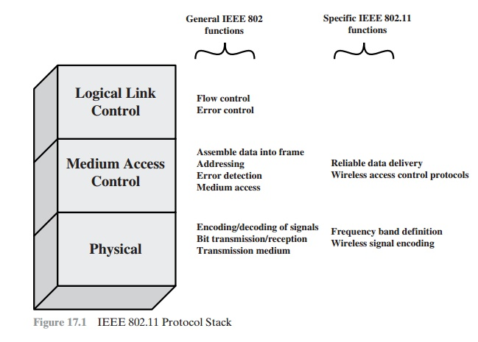
IEEE 802.11 Medium access control
Functionality of MAC
Reliable data delivery
Fairly control access
Protection of data

Slide 41
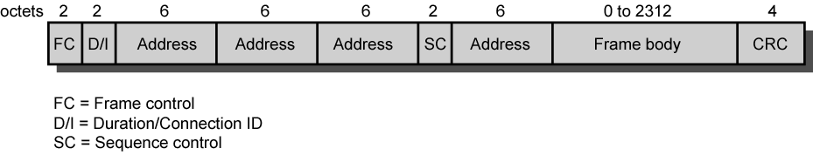
IEEE 802.11 MAC Frame Format
Frame Control:
Type of frame
Control, management, or data
Provides control information
Includes whether frame is to or from DS (Distributed System), fragmentation information, and privacy information
Duration/Connection ID:
If used as duration field, indicates time (in µs) channel will be allocated for successful transmission of MAC frame
In some control frames, contains association or connection identifier
Addresses:
Number and meaning of address fields depend on context
Types include source, destination, transmitting station, and receiving station
Sequence Control:
4-bit fragment number subfield for fragmentation and reassembly
Sequence number used to number frames between given transmitter and receiver
Frame Body:
MSDU (or a fragment of)
LLC PDU or MAC control information
MSDU:MAC Service Data Unit
Frame Check Sequence:
32-bit cyclic redundancy check

Slide 42
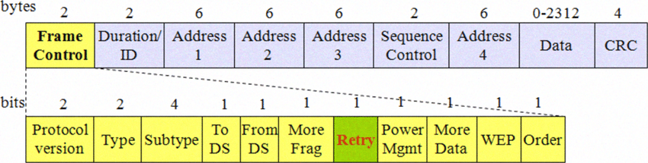
IEEE 802.11 MAC Frame Format
used to indicates a receiver that a sender has more data to send than the current frame.
It is 1 bit long field, if the current frame is a retransmission of an earlier frame, this bit is set to 1.
It is 1 bit long field which indicates that the standard security mechanism of 802.11 is applied
It is a 1 bit long field which when set indicates frame coming from DS.
It is 1 bit long field, if this bit is set to 1 the received frames must be processed in strict order.
It is a 2 bit long field which indicates the current protocol version which is fixed to be 0 for now.
It is 1 bit long field which when set to 1 means frame is followed by other fragments.
It is a 1 bit long field which when set indicates that destination frame is for DS(distribution system).
It is 1 bit long field which indicates the mode of a station after successful transmission of a frame.
1: indicates that the station goes into power-save mode.
0 : indicates that the station stays active.
4 bit long field which indicates sub-type of the frame like 0000 for association request, 1000 for beacon.
It is a 2 bit long field which determines the function of frame i.e management(00), control(01) or
data(10).
The value 11 is reserved.
Figure reference: https://www.researchgate.net/figure/Figure-l-General-IEEE-80211-MAC-layer-frame-format_fig2_224128362

Slide 43
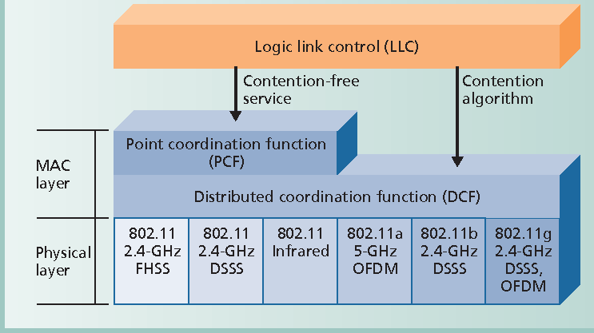
IEEE 802.11 Protocol Architecture
PCF uses
Centralized MAC algorithm
Contention free
Built on top of DCF
DCF uses Contention algorithm to provide access to all traffic

Slide 44
Distributed Coordination Function (DCF)
DCF sub layer uses CSMA
If station has frame to transmit, it listens to medium
If medium idle, station may transmit
Otherwise must wait until current transmission complete
No collision detection
Not practical on wireless network
Dynamic range of signals very large
Transmitting station cannot distinguish incoming weak signals from noise and effects of own transmission
DCF includes delays
Amounts to priority scheme
Inter-frame space

Slide 45
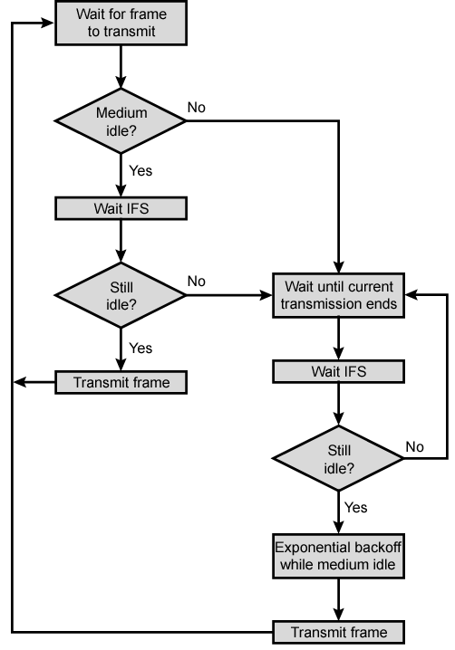
IEEE 802.11 Medium Access Control Logic
Single delay known as interframe space (IFS)
Using IFS, rules for CSMA:
Station with frame senses medium
If idle, wait to see if remains idle for one IFS. If so, may transmit immediately
If busy (either initially or becomes busy during IFS) station defers transmission
Continue to monitor until current transmission is over
Once current transmission over, delay another IFS
If remains idle, back off random time and again sense
If medium still idle, station may transmit
During backoff time, if becomes busy, backoff timer is halted and resumes when medium becomes idle
To ensure stability, binary exponential backoff used

Slide 46
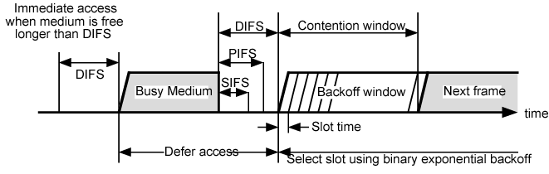
Three values for IFS
SIFS (short IFS):
Shortest IFS
For all immediate response actions
PIFS (point coordination function IFS):
Midlength IFS
Used by the centralized controller in PCF scheme when issuing polls
DIFS (distributed coordination function IFS):
Longest IFS used as minimum delay for asynchronous frames contending for access

Slide 47
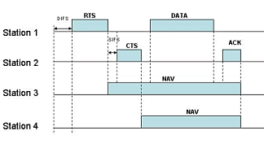
Point Coordination Function (PCF)
Alternative access method implemented on top of DCF
Polling by centralized polling master (point coordinator)
Uses PIFS when issuing polls
PIFS smaller than DIFS
Can seize medium and lock out all asynchronous traffic while it issues polls and receives responses
E.g. wireless network configured so number of stations with time-sensitive traffic controlled by point coordinator
Remaining traffic contends for access using CSMA
Point coordinator polls in round-robin to stations configured for polling
When poll issued, polled station may respond using SIFS
If point coordinator receives response, it issues another poll using PIFS
If no response during expected turnaround time, coordinator issues poll

Slide 48
IEEE 802.11 Physical layer

Slide 49
IEEE 802.11 Physical layer
Issued in 4 stages
First part in 1997
IEEE 802.11
Includes MAC layer and three physical layer specifications
Two in 2.4-GHz band and one infrared
All operating at 1 and 2 Mbps
Two additional parts in 1999
IEEE 802.11a
5-GHz band up to 54 Mbps
IEEE 802.11b
2.4-GHz band at 5.5 and 11 Mbps
Most recent in 2002
IEEE 802.g extends IEEE 802.11b to higher data rates

Slide 50
802.11 - Physical layer (classical)
The architecture of the Physical layer comprises of the two sub layers for each station:
Physical Layer Convergence Procedure (PLCP):
PLCP sub layer is responsible for the Carrier Sense (CS) part of the Carrier Sense Multiple Access/Collision Avoidance (CSMA/CA) protocol.
PLCP layer prepares the MAC Protocol Data Unit (MPDU) for transmission.
The PLCP also delivers the incoming frames from the wireless medium to the MAC layer.
Physical Medium Dependent (PMD):
The PMD provides the actual transmission and reception of physical layer entities between stations through the wireless media.
This sub layer provides the modulation/demodulation of the transmission.

Slide 51
FHSS Physical Layer
In Frequency Hopping Spread Spectrum (FHSS) mode, the layer carries the clocking information to synchronize the receiver clock with the clock of the transmitted packet.
FHSS PMD is responsible for converting the binary bit sequence into analog signal and transmit the PPDU frame into the air.
FHSS PMD does this using the frequency hopping technique.

Slide 52
DSSS Physical Layer
DSSS PLCP is responsible for synchronizing and receiving the data bits correctly.
DSSS PMD translates the binary digital sequence into analog radio signals and transmits the PPDU frame into the air.
The DSSS physical layer operates within the ISM band.

Slide 53
Hidden Terminal Problem
A
B
C
In this problem, the transmission range of A reaches B but not C. Similarly, the range of C reaches B but not A. Also the range of B reaches both A and C.
A hidden terminal problem occurs when two nodes that are outside each other’s range performs simultaneous transmission to a node that is within the range of each of them resulting in a collision.
One solution to avoid this is to have the channel sensing range much greater than the receiving range. Another solution is to use the Multiple Access with Collision Avoidance (MACA).
Now, the node A starts to send something to B and C, but C doesn’t receive this transmission.
Now C also wants to send data to B and senses the carrier. As it senses it to be free, it also starts sending to B.
That means the data from both parties A and C will be lose during the collision.
Hidden nodes mean increased probability of collision at the receiver end.

Slide 54
Wi-fi Protected Access

Slide 55

Wired Equivalent Privacy (WEP)
Wired Equivalent Privacy (WEP) is a security algorithm for IEEE 802.11 wireless networks.
WEP was designed to protect users of a WLAN from casual eavesdropping.
It was intended to offer the following facilities:
Reasonably strong encryption - It relies on the difficulty of recovering the secret key through a brute force attack. The difficulty grows with the key length.
Self-synchronizing - Each packet contains the information required to decrypt it. There is no need to deal with lost packets.
Efficient - It can implement in software with reasonable efficiency.
Exportable - Limiting the key length leads to a greater possibility of export.

Slide 56
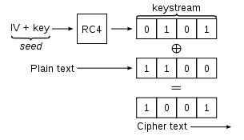
Wired Equivalent Privacy (WEP)
The WEP algorithm is the RC4 cryptographic algorithm from RSA data security.
RC4 uses a stream cipher technique.
It is a symmetric algorithm and uses the same key for both enciphering and deciphering the data.
For each transmission, the plaintext is bitwise XORed with a pseudorandom keystream to produce ciphertext.
For decryption, the process reversed.

Slide 57
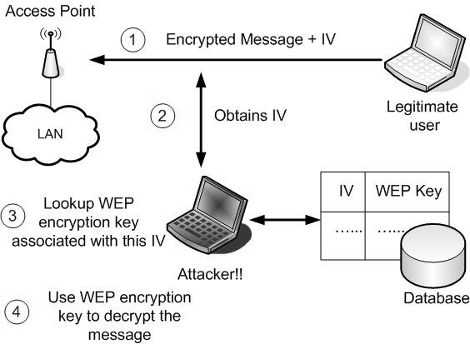
Weakness of WEP

Slide 58
Wi-Fi Protected Access-WPA
Wi-Fi Protected Access (WPA) is a security standard to secure computers connected to a Wi-Fi network.
It was developed in response to the weaknesses of WEP (Wired Equivalent Privacy) and therefore improves on WEP's authentication and encryption features.
WPA provides two algorithms:
Temporal Key Integrity Protocol (TKIP)
Advanced Encryption Standard (AES)
Wi-Fi Protected Access included a 128-bit “temporary key integrity protocol” (TKIP) which dynamically produces a new key for each data packet.

Slide 59
WPA Standards
Wi-Fi Protected Access (WPA) and WPA2 are concurrent security standards.
WPA addressed the majority of the IEEE 802.11i standard, and the WPA2 certification achieved full compliance.
WPA-Personal developed for home and small office use.
WPA-Enterprise was developed for large businesses and requires a RADIUS authentication server that provides automatic key generation and authentication throughout the entire enterprise.

Slide 60
Possible Attacks
The possible security attacks on wireless LAN are:
Passive attack
To decrypt traffic based on statistical analysis.
Active attack
To inject new traffic from unauthorized mobile stations, based on known plaintext.
To decrypt traffic, based on tricking the access point.
Dictionary-building attack
After analysis of about a day’s worth of traffic, allows real-time automated decryption of all traffic.
Hijacking a session
Following successful authentication, it is possible to perform them using the inexpensive off-the-shelf equipment.

Slide 61
802.1X Authentication
To prevent attacks on wireless LAN, the IEEE specification committee on 802.11 included the 802.1x authentication framework.
The 802.1x framework provides the link layer with extensible authentication, normally seen in higher layers.
802.1x requires three entities.
The supplicant Resides on the wireless LAN client
The authenticator Resides on the access point
The authentication server Resides on the server authenticating the client (e.g., RADIUS Kerberos, or other servers)
‘Supplicant’
‘Authenticator’
‘Authentication Server’
Client Device with Wireless Network Interface Card
Authentication Authorization, and Accounting Server
Access Point
Encapsulated EAP Message typically on RADIUS

Slide 62

References
Book: | Wireless Communications & Networks, Second Edition, William Stallings by Pearson
Web: | https://www.ieee802.org/11/

Slide 63
Unit-4: Wi-Fi and the IEEE 802.11 Wireless LAN Standard
Mobile Computing Wireless Communication
(MCWC)
GTU # 2170710
Prof.Swati R Sharma
Computer Engineering Department
swati.sharma@darshan.ac.in
(O) 9727747317

